Slide 1
Lab 10
Name: Hassnain
Roll No: 0013
Subject DSA

Slide 2
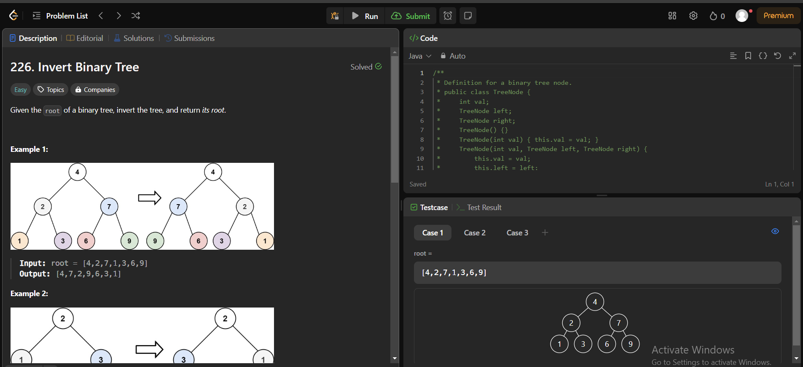
Task 01

Slide 3
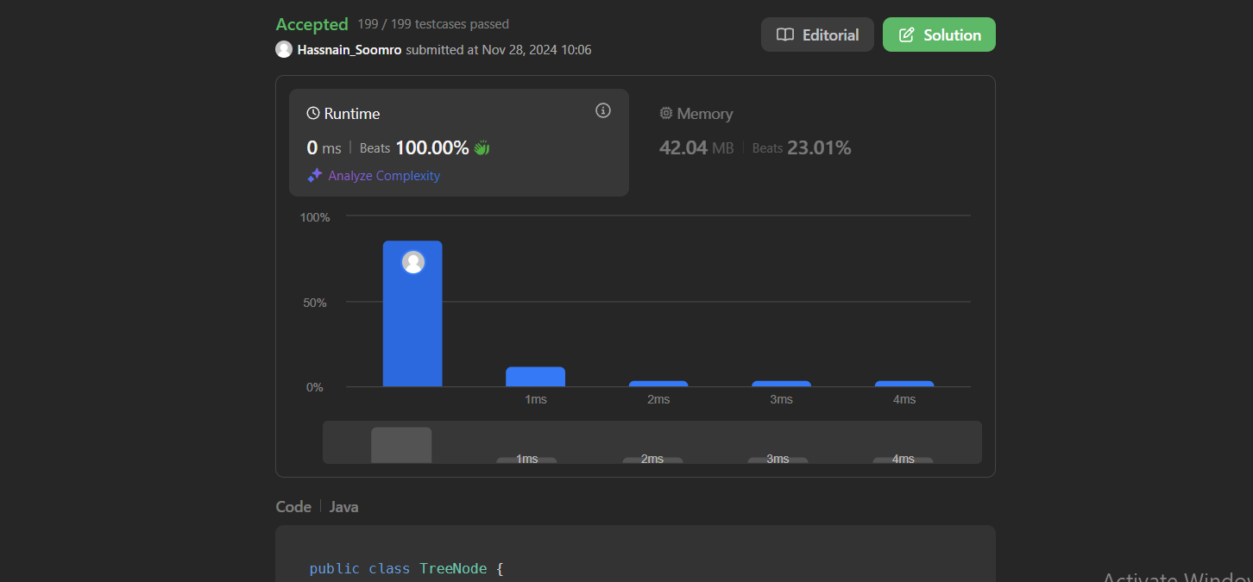
Task 02

Slide 4
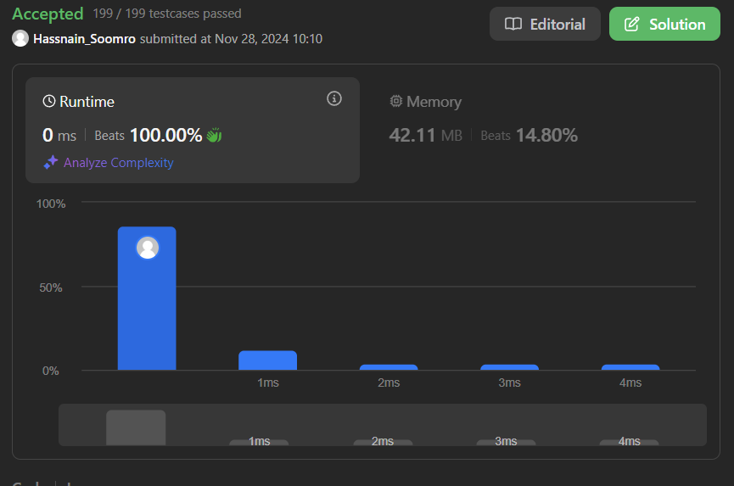
Task 03

